Slide 1
American Express Default Prediction
Sprint 4
Group A1_04

Slide 2

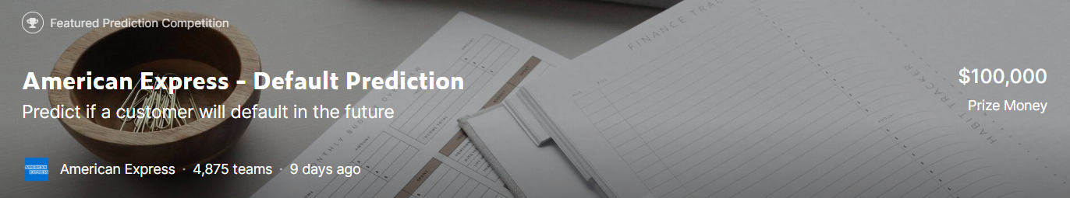

Background Review
The competition is sponsored by American Express, the world's largest payment card issuer with high industry recognition and is a classic risk control competition. In this competition, machine learning skills will be used to predict credit defaults. Specifically, industrial-scale data is used to build machine learning models. The training, validation and testing datasets include time series behavioral data and anonymous customer feature information.
https://www.kaggle.com/competitions/amex-default-prediction
Notes:
To sum up, our target is to predict the likelihood that a customer will not pay their credit card balance in the future based on their monthly customer profile.

Slide 3

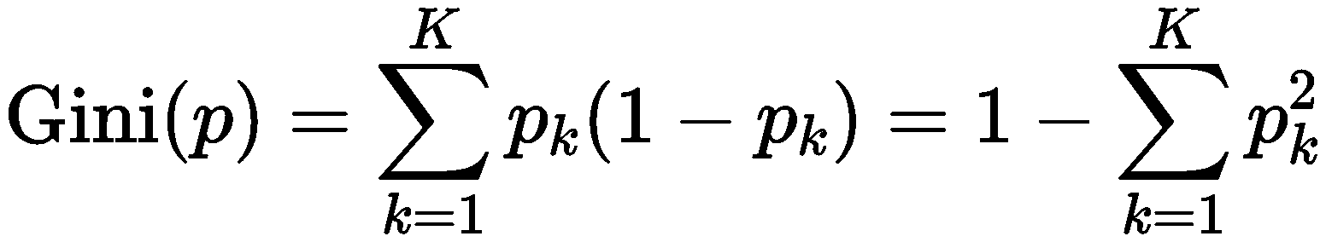
Dataset Review
Dataset features:
Anonymous profile information
Time-series behavioral features
Tag：Failure to pay within 120 days, tagged as 1
D_* = Delinquency variables
S_* = Spend variables
P_* = Payment variables
B_* = Balance variables
R_* = Risk variables
Metrics：
G：Normalized Gini Coefficient
D：Default rate captured at 4%
M = 0.5G + 0.5D
Dataset compression:
https://www.kaggle.com/datasets/raddar/amex-data-integer-dtypes-parquet-format
Notes:
And in last sprint we focused on some dataset features.
Different categories of data.
how do we define whether a customer has default
Failure to pay within 120 days, it is considered as a default
In Sprint 1 a classmates asked a question about the metrics; I didn’t answer it correctly. so here is a detailed illustration. This part consists of a lot of probability and statistics concepts. Actually, I have just learned them for a lecture called Stochastic Process. So if you think there are something wrong with my presentation, feel free to tell that. First, let’s skip these scary equations and look at an example. But just remember that the evaluation function consists of two parts, G and D.

Slide 4
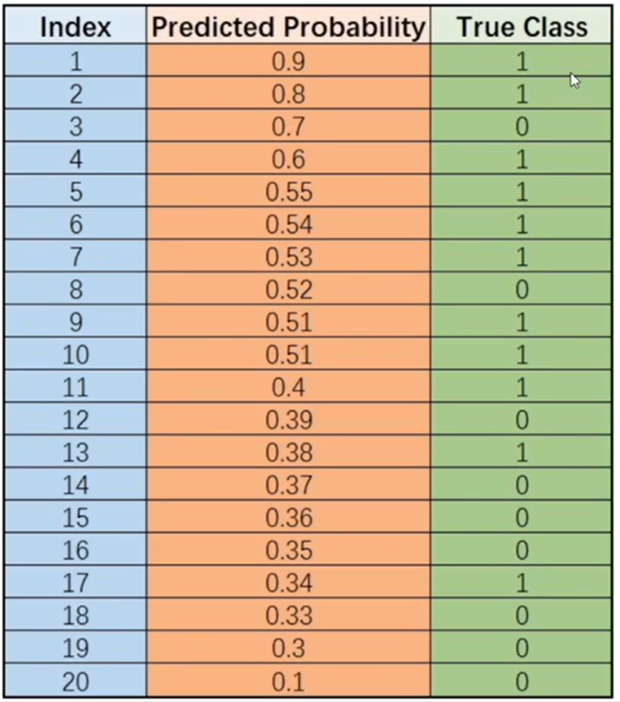
Metric
Bayes risks:
Cost of false alarm (false positive)
Cost of misdetection (false negative)
Threshold 0.85:
True positive: 1
False positive: 0
True negative: 9
False negative:10
True positive rate = Pr(predict positive|actually positive)=1/9
False positive rate = Pr(predict positive|actually negative)=0
Threshold 0.5:
True positive: 8
False positive: 2
True negative: 7
False negative:3
True positive rate = 8/11
False positive rate = 2/9
Notes:
Here are 20 samples predicted by a machine learning model
Columns:
True class: tagged 1 or 0, 1 represents the customer has actually defaulted
Predicted probability: the probability that the customer will default, generated by the machine learning model.
But we don’t need vague probabilities, we need the model to tell us whether a customer will default or not.
So for example we set 0.5 as a threshold. Then all samples above 0.5 will be predicted as 1, and others 0
However, think about a question. Is 0.5 the best threshold?
When we predict a customer to be default, but actually he will not default. What’s the cost?
The bank may lose this customer
When we predict a customer to be not default, but actually he will default. What’s the cost?
The bank may lose money. The bank will not take back the money, which is a very bad thing to happen.
The bank is able to tolerate the lost of a customer. But it doesn’t want to tolerate the lost of money. So I say the cost of false alarm is small, but the cost of misdetection is huge. How do we solve this unbalance, we can change the threshold.

Slide 5
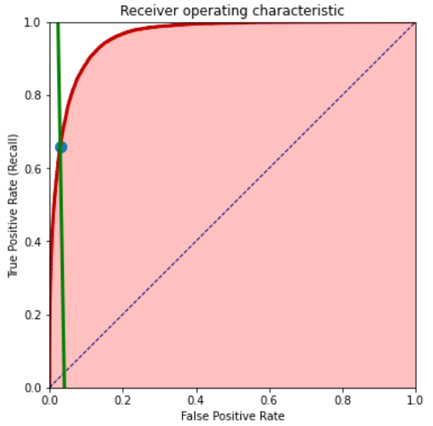
Metric
Normalized Gini Coefficient (G): G= 2 * AUC-1，-1<G<1, The larger the light red area, the better the score is.
Default rate captured at 4 % (D)：The true positive rate (recall) for a threshold set at 4 % of the total (weighted) sample count. It corresponds to the y coordinate of the intersection between the green line and the red roc curve (marked with a green dot) and is always between 0 and 1. The higher the intersection point, the better is the score.
The competition metric is the average of these two components. In other words: They want us to simultaneously optimize for a large red area under the curve and a high intersection point with the green line.
https://www.kaggle.com/code/ambrosm/amex-keras-quickstart-1-training
https://www.kaggle.com/code/inversion/amex-competition-metric-python
Notes:
If we plot this two points on a graph, here and here
So we know decreasing the threshold, is actually moving the point from left to right.
The curve is called ROC curve, which means receiver operating characteristic.
AUC: Area under Curve
Means that we consider all the threshold. Stands for the overall score of this predictor.
The larger the better. In other words, We want the curve to be as convex as possible
Normalized Gini Coefficient G is the 2 times AUC minus 1, which represent the area of this part.
And Default rate captured at 4 % (D) is this intersection of the line of 4%, which means that if the cost of a false alarm is 4, then the cost of misdetection is 96. This is given by the American Express team, which justifies that we want the false positive to be smaller, even though the true positive rate will be smaller.
So this is a graphical explanation of the competition metrics, hope you guys can understand that.
So let’s go back to this equation.
The weight of G and D: 0.5 and 0.5, is given by Kaggle. More seemingly determined by experience

Slide 6
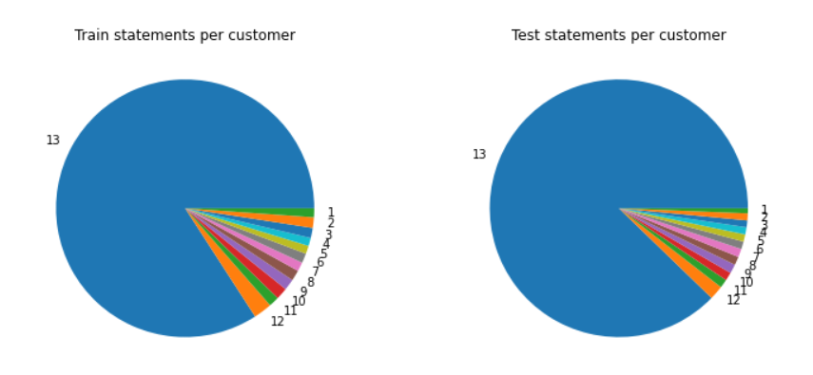
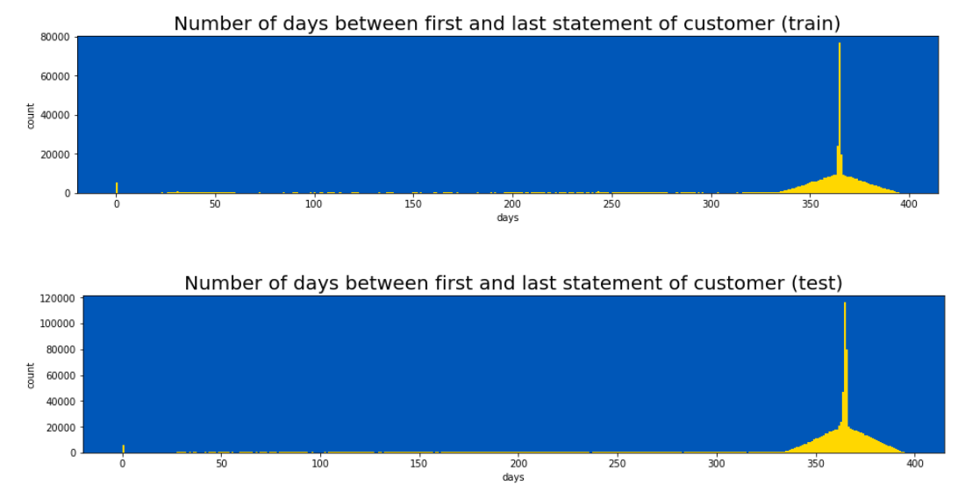
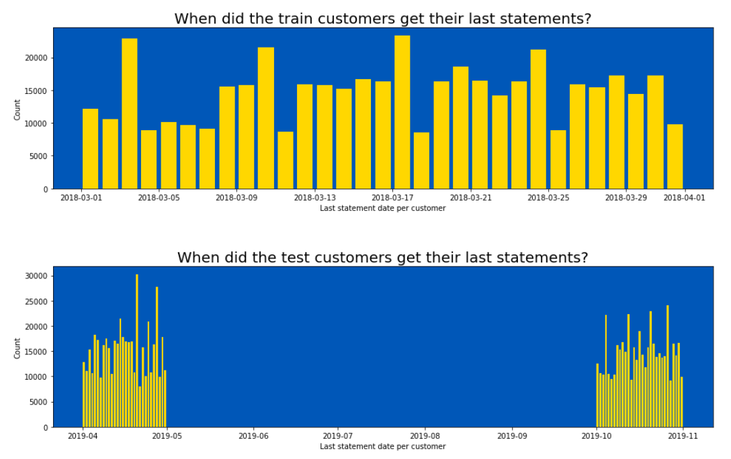
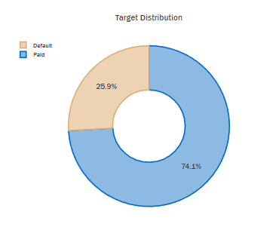
EDA
80% customers have 13 behavior records
20% customers have 1-12 behavior records
26% are default
The last statements of train customers are in 2018.3
The last statements of some test customers are in 2019.4 (public LB)
The last statements of the other test customers are in 2019.10(private LB)
Notes:
In last sprint we introduce the data visualization. And we did a little more on this recently. And we replotted some graphs to make it more clear to read.

Slide 7
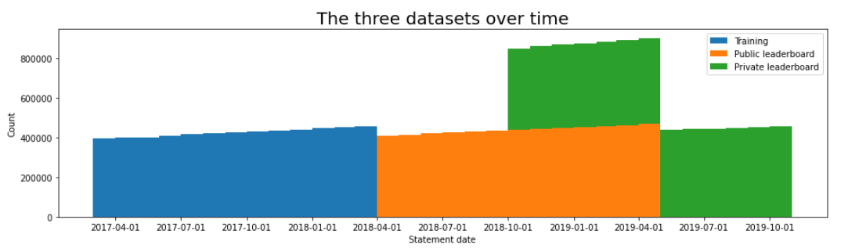
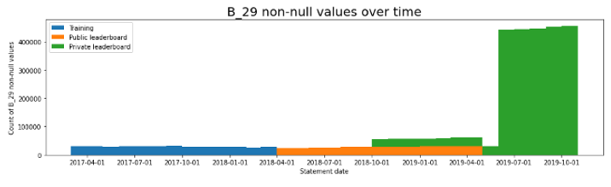
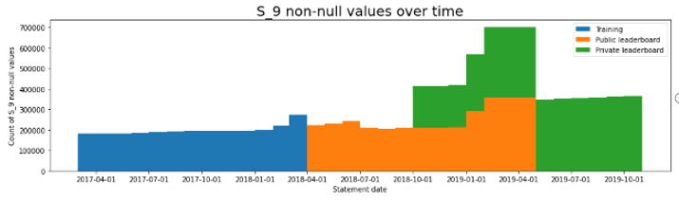
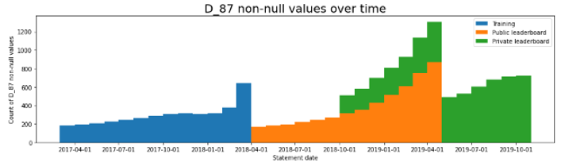
EDA
private LB from 2018.10 to 2019.04
Large number of features from 2019.07 to 2019.10 B29
https://www.kaggle.com/code/ambrosm/amex-eda-which-makes-sense

Slide 8
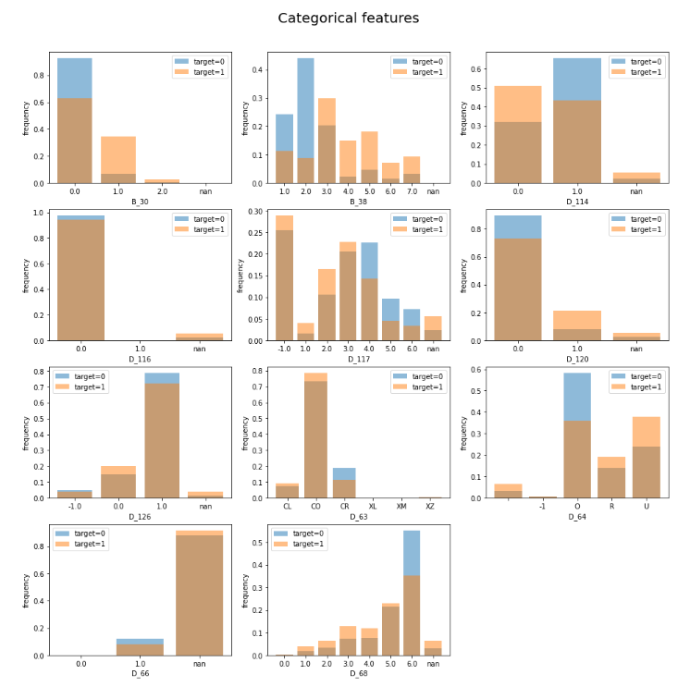
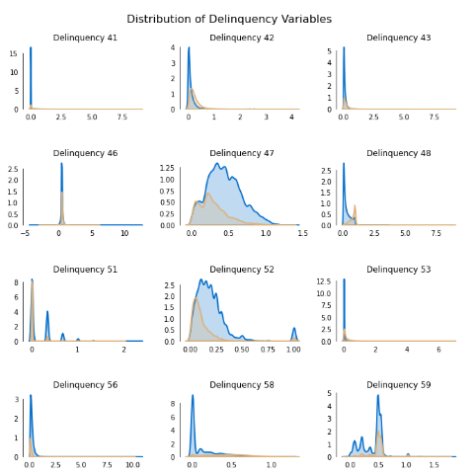
EDA

Slide 9

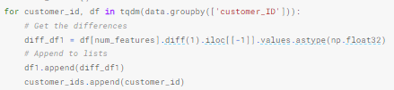

Feature Engineering
Aggregated features based on behavior
Fluctuation features
Extended meaning-based
features
Notes:
We also did some feature extraction jobs. For example, we calculated the Statistical features: mean, standard deviation, minimum, maximum for numerical variables. First and Last means the first and the last element of a column. Sometimes they are very useful because it represents the original and the last state of the variable. And some features are from the community, hard to explain why they work. Use it because the result will be better.
Because this should be a short presentation. We don’t want it to make it too long so we are going to leave the detailed feature engineering to next sprint.
Welcome Marcel to introduce one of the models we will use.

Slide 10
Feature Engineering
- Delete features D_103, D_139
- Calculate sum for features such as send_p+payment_p+delq+balance_p to construct new features
- Construct first-last and last-mean features, i.e., divide the difference between the initial and final states of the customer
- Add fluctuating features, i.e., make differences between 1, 2, 3 states of the change interval of the features
- Aggregate features of count, nunique, std, and first are added to the category features, and std, mean, min, and max statistical features are derived from them.
- Count each customer customer_ID and the same date to create the consumption count feature
- Calculate customer "intermediate state" features for customers with multiple customer states, since we assume that this will help us cover most of the customer's variations
- Calculate lag_features, i.e. subtract and divide the minimum maximum of some features
- P2B9 feature construction
- Subtract and divide numerical features by themselves and by the mean, and subtract and divide the maximum and minimum values of some features

Slide 11

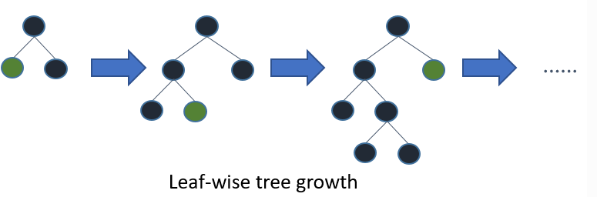
Light GBM
Gradient Boosting Framework that uses tree based learning algorithms (Microsoft, 2016)
Advantages:
Faster training speed and higher frequency
Lower memory usage
Better accuracy
Support of parallel, distributed, and GPU learning
Capable of handling large-scale data
https://www.kaggle.com/code/ambrosm/amex-lightgbm-quickstart
Notes:
Gradient boosting is a type of machine learning boosting. It relies on the intuition that the best possible next model, when combined with previous models, minimizes the overall prediction error. The key idea is to set the target outcomes for this next model in order to minimize the error.
(https://www.displayr.com/gradient-boosting-the-coolest-kid-on-the-machine-learning-block/)
(https://becominghuman.ai/lightgbm-on-home-credit-default-risk-prediction-5b17e68a6e9)

Slide 12
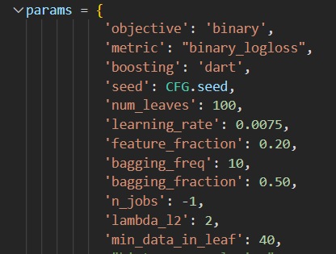
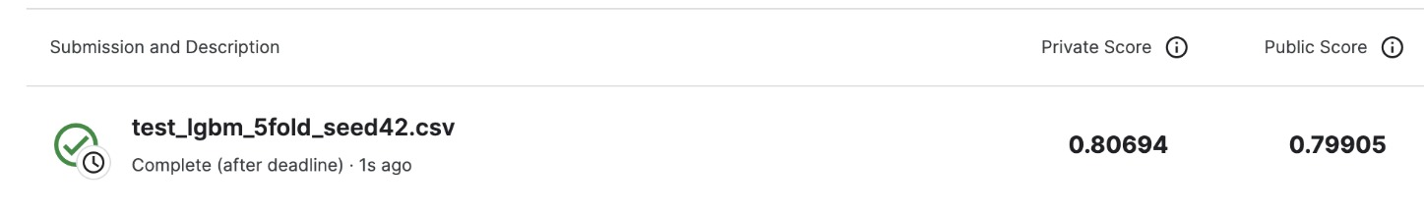
Light GBM
Binary: requires the given data set to be classified in two categories
Dart: ensemble model of boosted regression trees – high prediction accuracy
Bagging freq: after every 10 activations, randomly select 50% of data to use for the next k iterations
Num_boost_round: Number of boosting operations
Notes:
Objective: binary – Dependant variable is binary, 1 or 0, it will be a classification problem
Metric: binary_logloss – average # bits needed to identify an event drawn from the set if a coding scheme used for the set is optimized for an estimated prob distribution
Boosting: dart – ensemble model of boosted regression trees, high prediction accuracy.
Num_leaves: 100 –
Feature_extraction: 0.2 – every tree created will consider 20% of features (faster)
Learning_rate: 0.0075 - every tree created has “””””” of 0.0075
Bagging_fraction: 0.5 –
Bagging_freq: 10 – after every 10 activations, rand select 50% of obsv and use for next 10 iterations.
Min_data_in_leaf: 40 – minimal number of data in one leaf.
num_boost_round = 11500

Slide 13

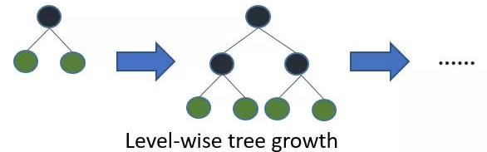
XGBoost
Some important features of XGBoost are:
Parallelization、Regularization、Non-linearity、 Cross-validation、Scalability
Advantages
Gradient Boosting comes with an easy to read and interpret algorithm, making most of its predictions easy to handle.
Boosting is a resilient and robust method that prevents and cubs over-fitting quite easily
XGBoost performs very well on medium, small, data with subgroups and structured datasets with not too many features.
It is a great approach to go for because the large majority of real-world problems involve classification and regression.
Disadvantages
XGBoost does not perform so well on sparse and unstructured data.
A common thing often forgotten is that Gradient Boosting is very sensitive to outliers since every classifier is forced to fix the errors in the predecessor learners.
The overall method is hardly scalable. This is because the estimators base their correctness on previous predictors, hence the procedure involves a lot of struggle to streamline.
Notes:
Gradient boosting is a type of machine learning boosting. It relies on the intuition that the best possible next model, when combined with previous models, minimizes the overall prediction error. The key idea is to set the target outcomes for this next model in order to minimize the error.
(https://www.displayr.com/gradient-boosting-the-coolest-kid-on-the-machine-learning-block/)
(https://becominghuman.ai/lightgbm-on-home-credit-default-risk-prediction-5b17e68a6e9)

Slide 14
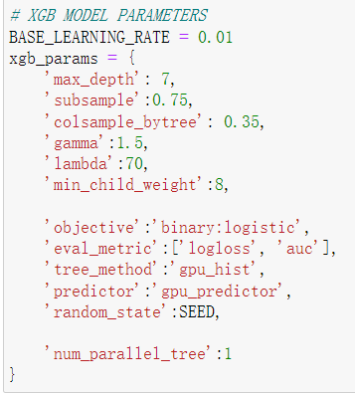
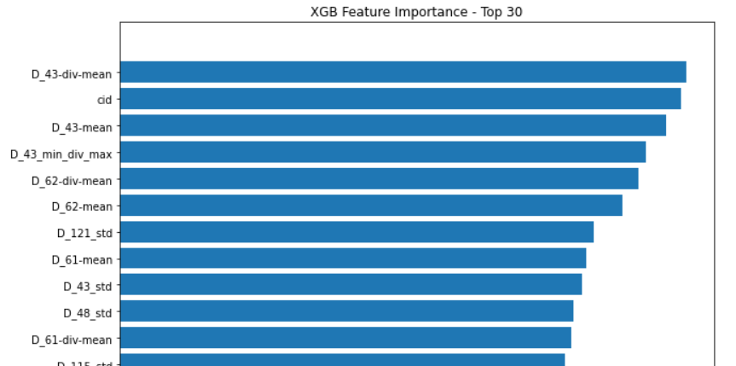

XGBoost
Notes:
Gradient boosting is a type of machine learning boosting. It relies on the intuition that the best possible next model, when combined with previous models, minimizes the overall prediction error. The key idea is to set the target outcomes for this next model in order to minimize the error.
(https://www.displayr.com/gradient-boosting-the-coolest-kid-on-the-machine-learning-block/)
(https://becominghuman.ai/lightgbm-on-home-credit-default-risk-prediction-5b17e68a6e9)

Slide 15
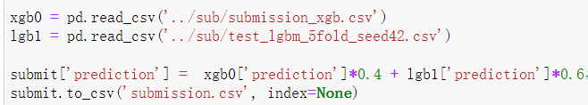
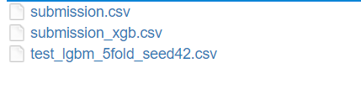
XGBoost
git: https://github.com/licao2998/EC601-A1-04
scc: /projectnb/ece601/team04/
Notes:
Gradient boosting is a type of machine learning boosting. It relies on the intuition that the best possible next model, when combined with previous models, minimizes the overall prediction error. The key idea is to set the target outcomes for this next model in order to minimize the error.
(https://www.displayr.com/gradient-boosting-the-coolest-kid-on-the-machine-learning-block/)
(https://becominghuman.ai/lightgbm-on-home-credit-default-risk-prediction-5b17e68a6e9)

Slide 16
Possible Improvements in the Future
Continue work on feature extraction
Try other models
Integrate models
Thank you!
Notes:
Continue work on feature extraction
by this I mean we not only need more features, but also need to delete some not useful features

